Slide 1
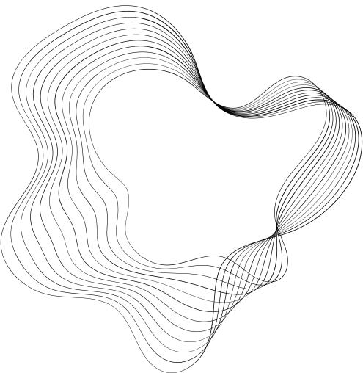

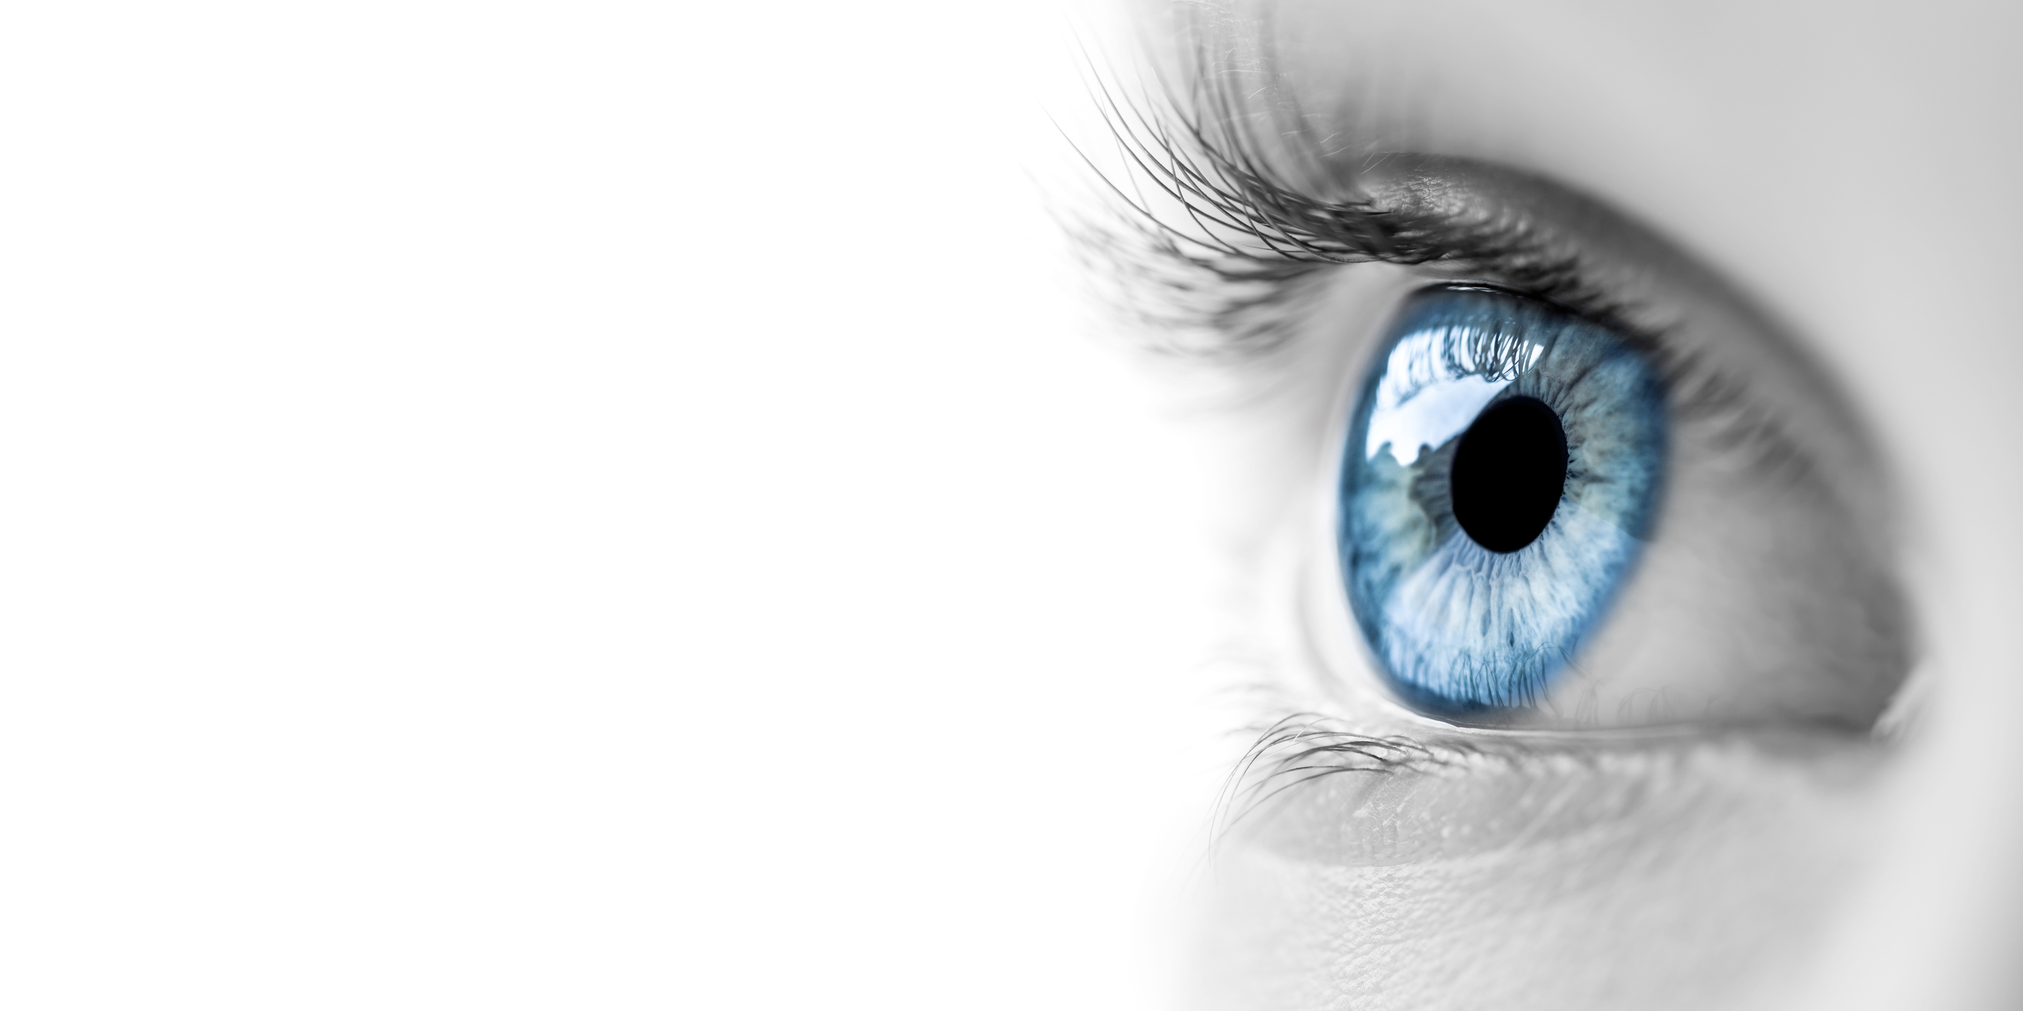
Enhancing Ocular Disease Diagnosis, blood vessel segmentation, and vessel diameter estimation using an advanced deep learning
CSE499B
Section: 23
Md. Marop Hossain | 2013982042
Md. Zunayed Islam Pranto | 1921609642
Tasnia Tasnim | 1912533642
Faculty Advisor:
Dr. Mohammed Ashrafuzzaman Khan
Assistant Professor
ECE Department

Slide 2
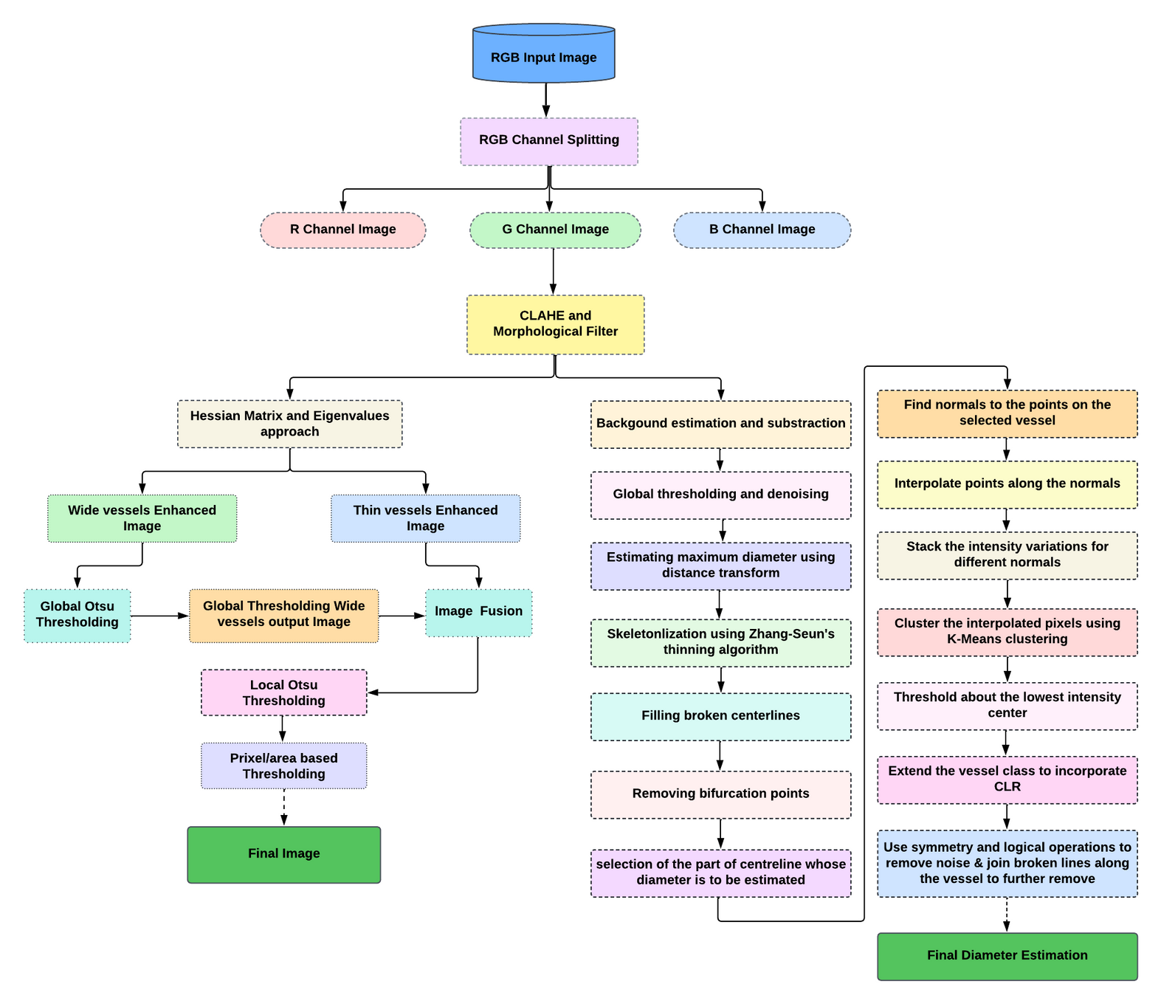
System Diagram
vessel segmentaion implementation
Colleting dataset : Collected training images
and corresponding segmented images.
RGB channel splitting: Splitting into read, green
and blue channel.
CLAHE and Morphological Filtration: To to
improve the contrast of images.
Hessian matrix and Eigenvalues approach:
produce improved images of wide
and thin blood vessels
Image Fusion: Combines global threshold
thick vessel image with thin vessel enhanced
image to create a fusion image.
Local Otsu Thresholding: Increases vessel visibility
while reducing noise and unnecessary objects.
Pixel/ area based Thresholding: Removes any pixels
below a threshold area (30px)
Final Output

Slide 3
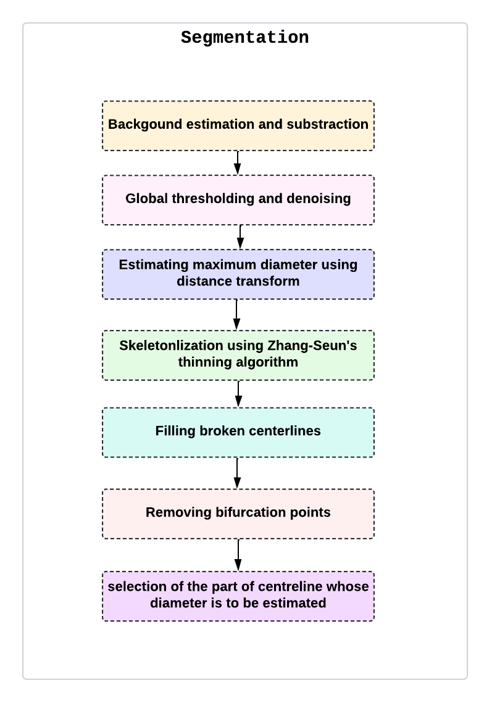
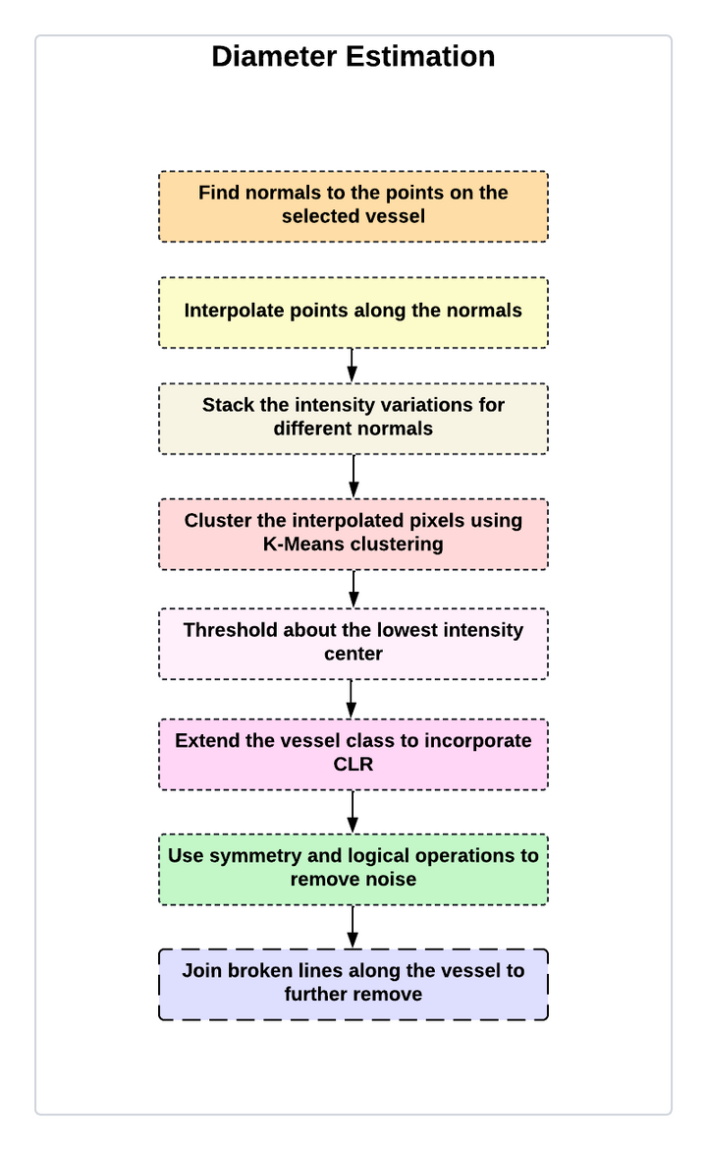
Vessel diameter estimation
1. Vessel Segmentation and Centreline Extraction
Background Subtraction: Highlights vessels by removing background
Thresholding: Converts image to binary map (vessels as dark pixels)
Noise Removal: Eliminates small, isolated bright spots
Skeletonization: Thins vessels to single-pixel lines and fills gaps
2. Interpolation Normal to Centrelines and Clustering
Normals Generation: Draws perpendicular lines along centrelines
Intensity Mapping: Creates a 3D map of intensity values along normals
Clustering: Isolates vessel pixels based on intensity
CLR Handling: Incorporates central light reflex using symmetry
Noise Reduction: Fills breaks and joins segments for a refined vessel profile
Key Outputs
Enhanced Vessel Images
Accurate Vessel Diameters

Slide 4
Analysis of the Design
We mainly focused on two parts of this project: blood vessel segmentation and vessel diameter estimation
First part: Blood vessel segmentation from ocular images
Diagnosing eye diseases depends extensively on the appearance and structure of blood vessels in retinal images. We applied a less computational, unsupervised automated technique with promising results for detecting retinal vasculature using a morphological hessian-based approach and region-based Otsu thresholding. After blood vessel segmentation, the doctor can be able to identify abnormalities in the blood vessels of the eye, including Glaucoma, age-related muscular degeneration (AMD), and Hypertension(high blood pressure)
Second part: Vessel's diameter estimation from ocular images
We needed to divide this part into vessel segmentation and centerline extraction, as well as interpolation normal to the centerlines and clustering. After going through this process, we can calculate vessel diameter (micrometer), which can be used to diagnose ocular and systemic vascular diseases, including coronary heart diseases, ischemia, and diabetes mellitus.

Slide 5
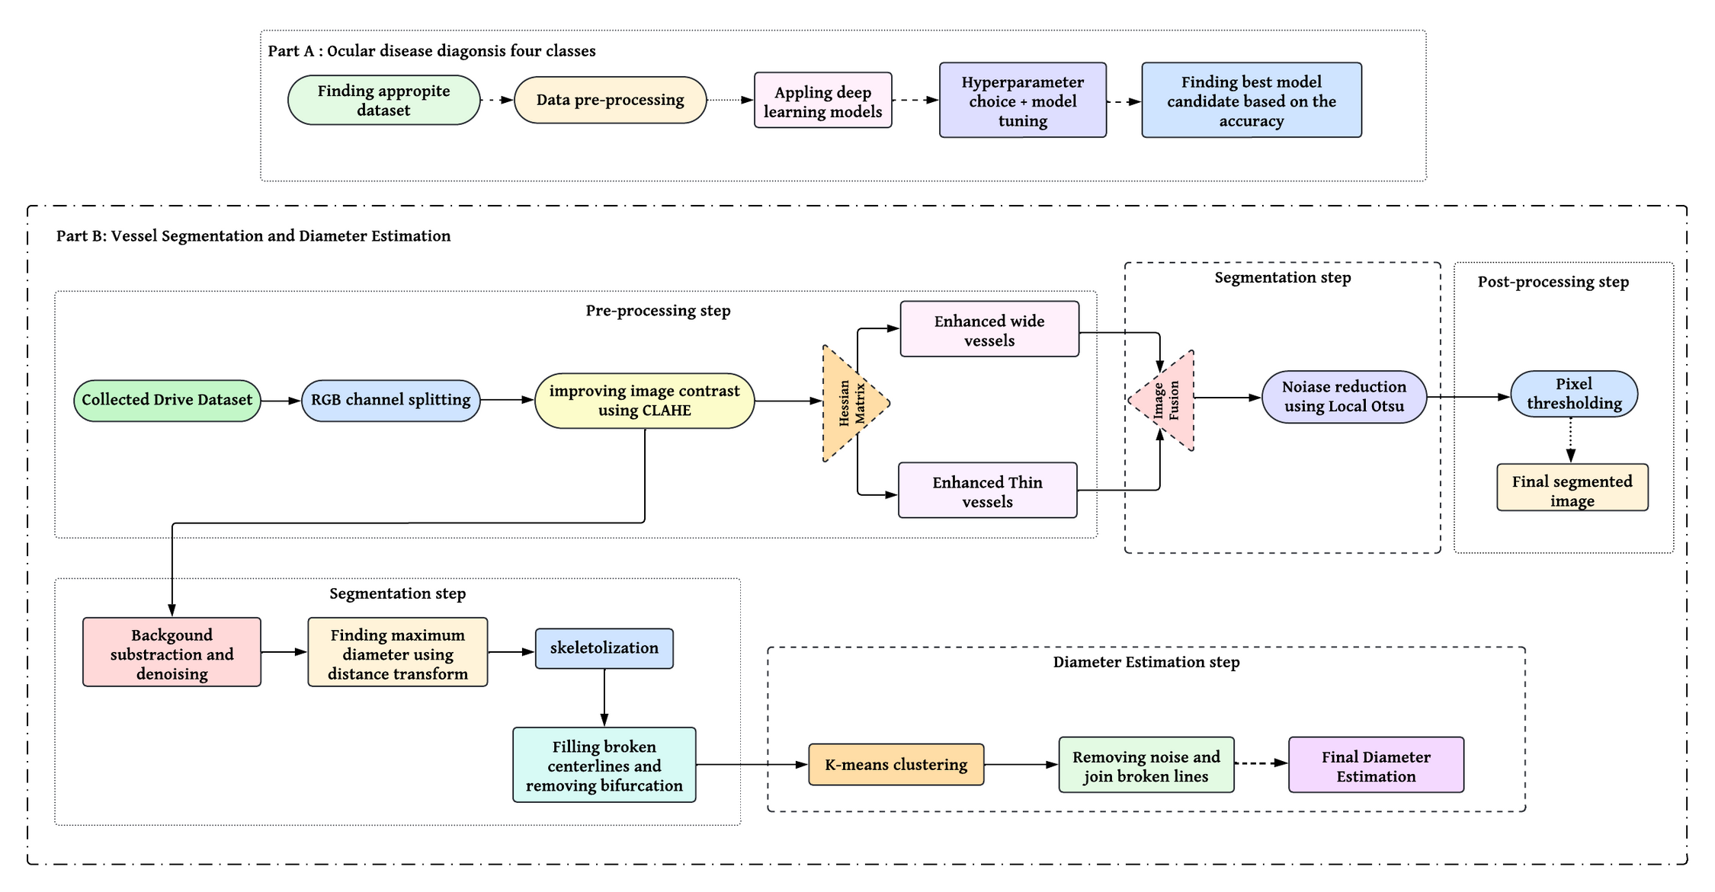
Development Process

Slide 6
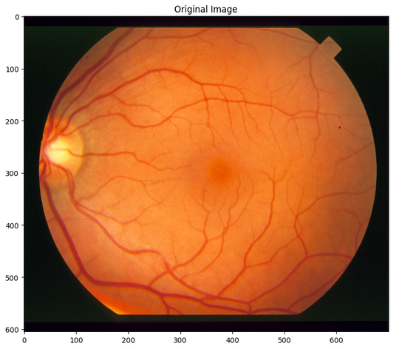
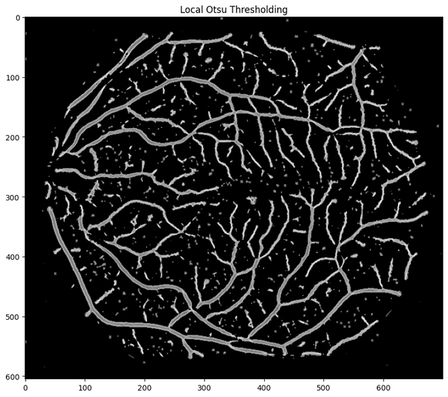
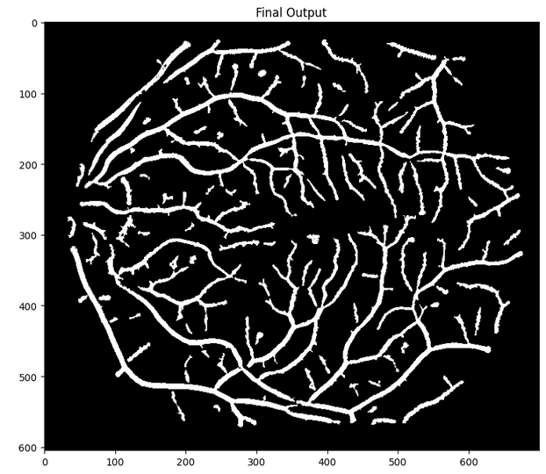
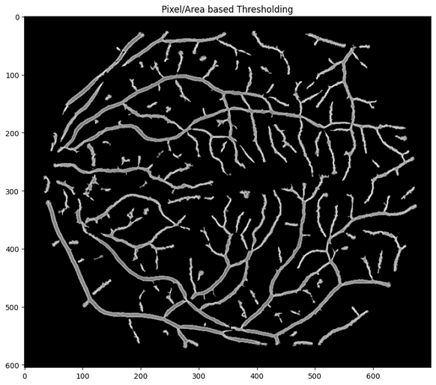
Result
Segmentation
Image No. | DRIVE dataset | DRIVE dataset | DRIVE dataset
Image No. | Accuracy | Sensitivity | Specificity
1 | 0.915 | 0.722 | 0.932
2 | 0.942 | 0.716 | 0.958
3 | 0.891 | 0.823 | 0.895
4 | 0.948 | 0.681 | 0.969
5 | 0.899 | 0.767 | 0.912
6 | 0.917 | 0.803 | 0.926
7 | 0.919 | 0.786 | 0.930
8 | 0.936 | 0.825 | 0.945
9 | 0.927 | 0.748 | 0.942
10 | 0.905 | 0.781 | 0.916
Input Image
Output Image

Slide 7
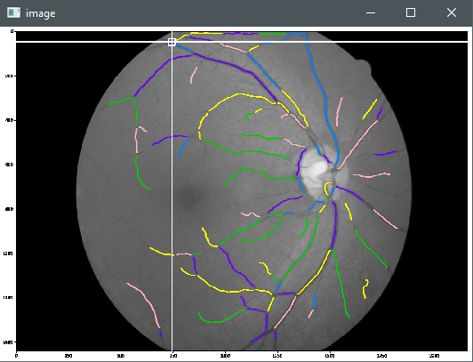
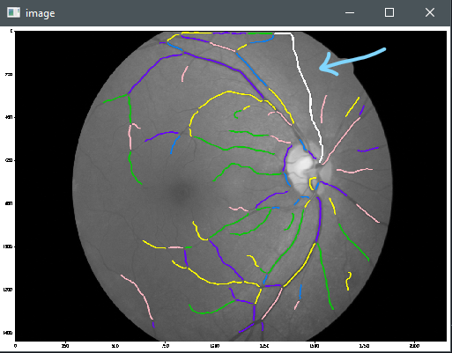
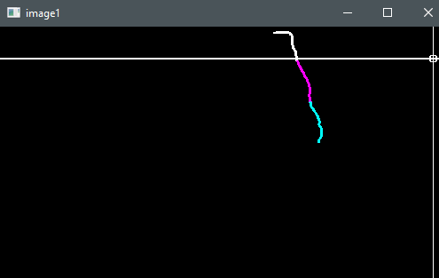
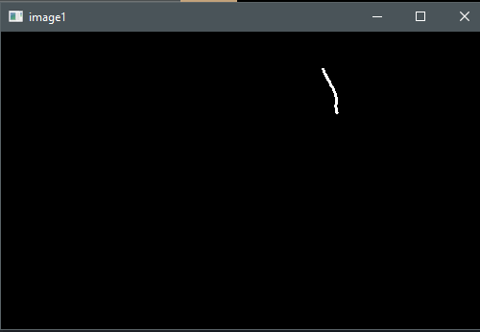
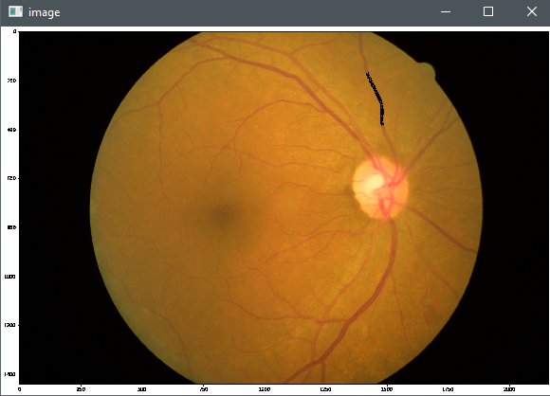
Result
Diameter Estimation:
selected vessel
SIZE IS : (779, 1166, 3)
Maximum diameter: 20.5044002532959 at the point: (732, 348)
In how many parts you want to divide the selected vessel (Please enter an integer <=5): 3
selected vessels and splited into 3 parts
Final Result
Average diameter length: 6.821138211382114
Median diameter length: 7.0
Standard deviation: 0.004640076349999139
selected part(middle) of the vessel for diameter estimation
selected part showing in the original fundus image

Slide 8
Tools & Technologies
Tools | Function | Why we selected this tool
TensorFlow | Deep Learning Framwork | TensorFlow is strong, flexible, and supported by the community. It offers many resources and features for building and training neural networks
Keras | High-level API for TensorFlow | It makes it easier to build and train deep learning models
OpenCV | open-source computer vision and cross-platform | It offers a broad range of functions and methods for tasks like image enhancement, segmentation, feature extraction, and image processing, including edge detection, morphology, and feature identification
Numpy, Pandas | Numpy handles arrays and mathematical operations, while pandas deals with structured data manipulation | Data preparation and analysis in eye disease detection were made more accessible using Numpy and Pandas due to their effective data handling, numerical computing, and deep learning integration.
Matplotlib, Seaborn, and Scikit-learn | Matplotlib and Seaborn provides Data visualization for analysis and presentation then Scikit-learn offers deep-learning algorithms for disease diagnosis and segmentation | It provides Widely used and well-documented tools for visualization and deep learning tasks essential for ocular disease diagnosis projects
Google Collab Pro | Cloud-based Jupyter Notebook environment | It provides solid GPUs and TPUs, available with Google Collab Pro, which helps train deep-learning models

Slide 9
Usability and Manufacturability
Usability:
Doctors can use segmented images for faster diagnosis of ocular diseases.
Find abnormalities in segmented vessel images.
Compare patent’s previous status with the present one, more faster and more accurately
Vessel diameter estimation will enable doctors to find farther reasons of ocular diseases occurring due to other organ malfunctions.
Manufacturability:
Manufacturing or implementing a single software, website, or web app to perform disease diagnosis of cataracts, glaucoma, and diabetic retinopathy along with blood vessel segmentation and vessel diameter estimation will make easier and cost effective for doctors. Farther training it with high quality mobile image instead of images generated by ophthalmoscope will increase it’s usability and make it available for the mass.

Slide 10
Environment Considerations & Sustainability
Environment Consideration:
A deep learning, AI-based approach for detecting ocular diseases will significantly reduce the medical wastage required for diagnosis. Also, it won’t require any physical data, or patent records to be stored psychical, instead, it will be cloud-based. Which will significantly reduce carbon footprint.
We have chosen the best models with the highest accuracy and more optimized methods that require less computation power to reduce the carbon footprint generated from Hardware and storage wastage.
Sustainability:
The sustainability of healthcare depends on the active participation of all stakeholders, fostering a culture of feedback and collaboration. By continuously refining and improving systems based on real-world experiences, we can ensure that healthcare remains adaptable, efficient, and effective in meeting the needs of both providers and patients.

